Slide 1
Republic HydroMeteorological Service of the Republika Srpska (one of the two entities hidrometeorological services in Bosnia and Herzegovina cares of meteo data over own territory ( no roof institution at BH level)
EUMETSAT Information day Skopje 13-14 March 2019.RS, B&H
Information Day
13-14 March 2019
Skopje, North Macedonia
EUMETSAT Information Day
13-14 March 2019
Skopje, North Macedonia
European Organization for
the Exploitation of
Meteorological Satellites
MONITORING WEATHER
AND CLIMATE FROM SPACE
rhmz@teol.net Republic Hydro-Meteorological Service of Republika Srpska, B&H www.rhmzrs.com

Slide 2
EUMETSAT Information day
FOCUS ON achivments between two meetings and present action
APPOINTMENTS
A new director has been appointed by the RS government: Mr Tomislav Šajić
DOCUMENTS:
new and additional legislative acts:
We expect new systematization of workplaces
- but with the old one we were not able to recruit urgent experts in meteorology and all other fields of activity
the problem of leaving professional staffs
proposal of the new law on hydrometeorological service
Regulation of the establishment of the national network of meteorological stations, program of work and of reporting
The rulebook of measures taken to protect the information system ...
rhmz@teol.net Republic Hydro-Meteorological Service of Republika Srpska, B&H www.rhmzrs.com

Slide 3
EUMETSAT Information day
FOCUS ON achivments between two meetings and present action
INITIATIVE:
Council of Ministers at the state level of BH held on September 25, 2018,
and the MCP BiH removed this issue from the agenda, and now the next step is:
Renew request to the Council of Ministers, and our common idea is that in addition to these activities within the ministries, the preparation and submission of an overall benefit analysis and cost-effectiveness approach to the ECMWF center
rhmz@teol.net Republic Hydro-Meteorological Service of Republika Srpska, B&H www.rhmzrs.com

Slide 4
EUMETSAT Information day
FOCUS ON the use of satellite imagery
We use satellite data from EUMETSAT DAWBEE station
Agreement on cooperation with Serbian RHMS allowed us to use their radar images, and products of numerical models that they have (ECMWF, NMM, NMM B, ETA)
Agreement on cooperation with DHMZ Croatia allowed us to use their radar images that cover our country from north
Online Workshop on the usage of Gridded Satellite Data for Climate Purpose in April 2018 (1 climatologist from RHMZ RS)
Advanced SEEMET training course in Primošten, Croatia from in May 2018 (1 forecaster from RHMZ RS)
rhmz@teol.net Republic Hydro-Meteorological Service of Republika Srpska, B&H www.rhmzrs.com

Slide 5
EUMETSAT Information day
FOCUS ON the use of satellite imagery
Drought Risk in the Danube Region: DriDanube:
"Drought watch" of DriDanube project team allows the user to browse, view and examine drought data sets. In this case, the phenomenon is a drought with its causes and consequences. Enabling access to data and drought-related products calculated on the basis of data collected over a perennial period, the Dry Monitoring Service adds the current component to the phenomenon and allows the user to examine the development and predict the possibility of drought in the areas of the Danube Basin and areas of project partners.
rhmz@teol.net Republic Hydro-Meteorological Service of Republika Srpska, B&H www.rhmzrs.com

Slide 6
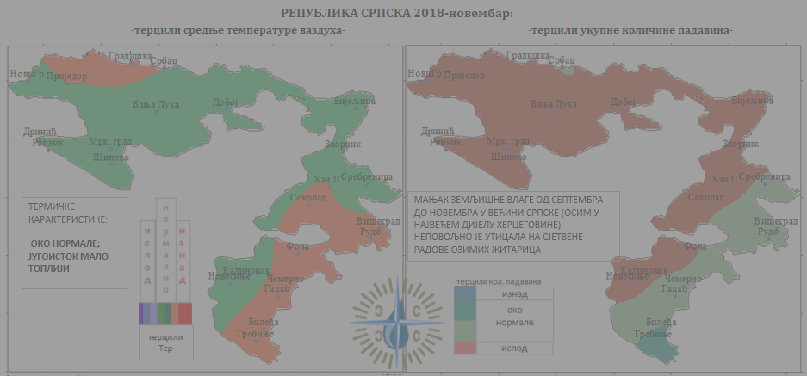
EUMETSAT Information day
FOCUS ON the use of satellite imagery
Drought Risk in the Danube Region: DriDanube:
Next to topographic map that gives users information about elevation, relief emphasized by the shadowing, the third option of the base map is the mosaic of satellite images of Cloudless Sentinel 2 by EOX IT Services GmbH.
Second, NUTS1 and NUTS3 data are provided by the European Commission through Eurostat.
rhmz@teol.net Republic Hydro-Meteorological Service of Republika Srpska, B&H www.rhmzrs.com

Slide 7
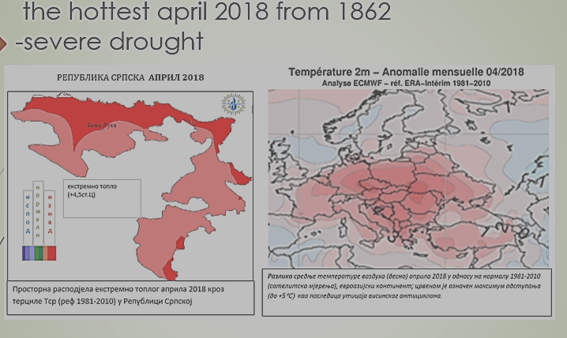
EUMETSAT Information day
FOCUS ON the use of satellite imagery
Drought Risk in the Danube Region: DriDanube:
Next to topographic map that gives users information about elevation, relief emphasized by the shadowing, the third option of the base map is the mosaic of satellite images of Cloudless Sentinel 2 by EOX IT Services GmbH.
Second, NUTS1 and NUTS3 data are provided by the European Commission through Eurostat.
rhmz@teol.net Republic Hydro-Meteorological Service of Republika Srpska, B&H www.rhmzrs.com

Slide 8
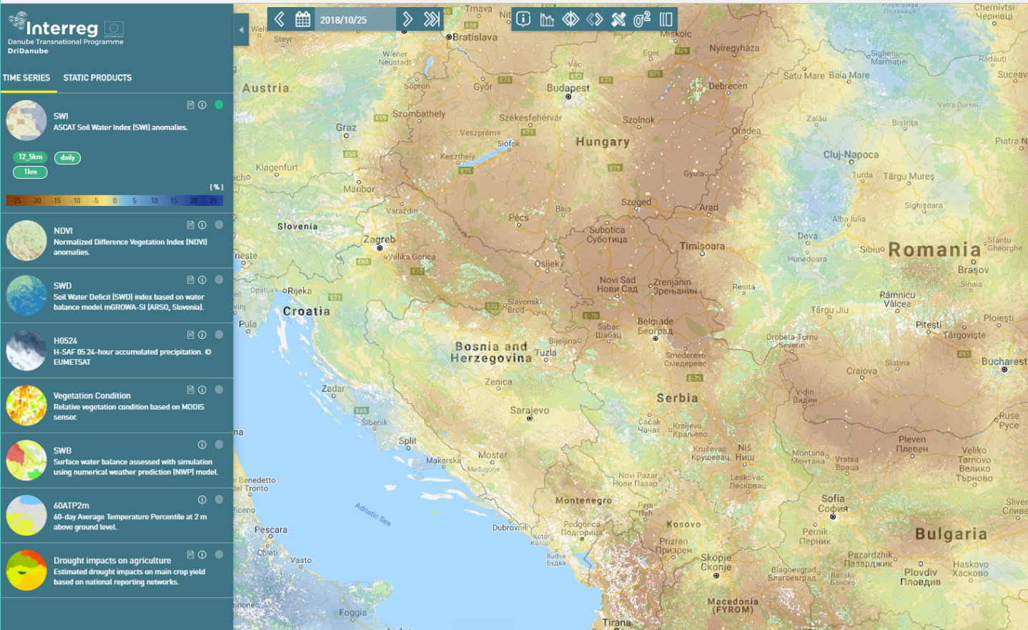
EUMETSAT Information day
FOCUS ON the use of satellite imagery: „Drought watch"
SWI daily pictures are produced from EUMETSAT ASCAT-25km surface moisture (SSM)
rhmz@teol.net Republic Hydro-Meteorological Service of Republika Srpska, B&H www.rhmzrs.com

Slide 9
EUMETSAT Information day
FOCUS ON the use of satellite imagery: „Drought watch"
The normalized vegetative difference index (NDVI) is a substitute for quantifying the amount of vegetation. It can refer to photosynthetic vegetation activity.
rhmz@teol.net Republic Hydro-Meteorological Service of Republika Srpska, B&H www.rhmzrs.com

Slide 10
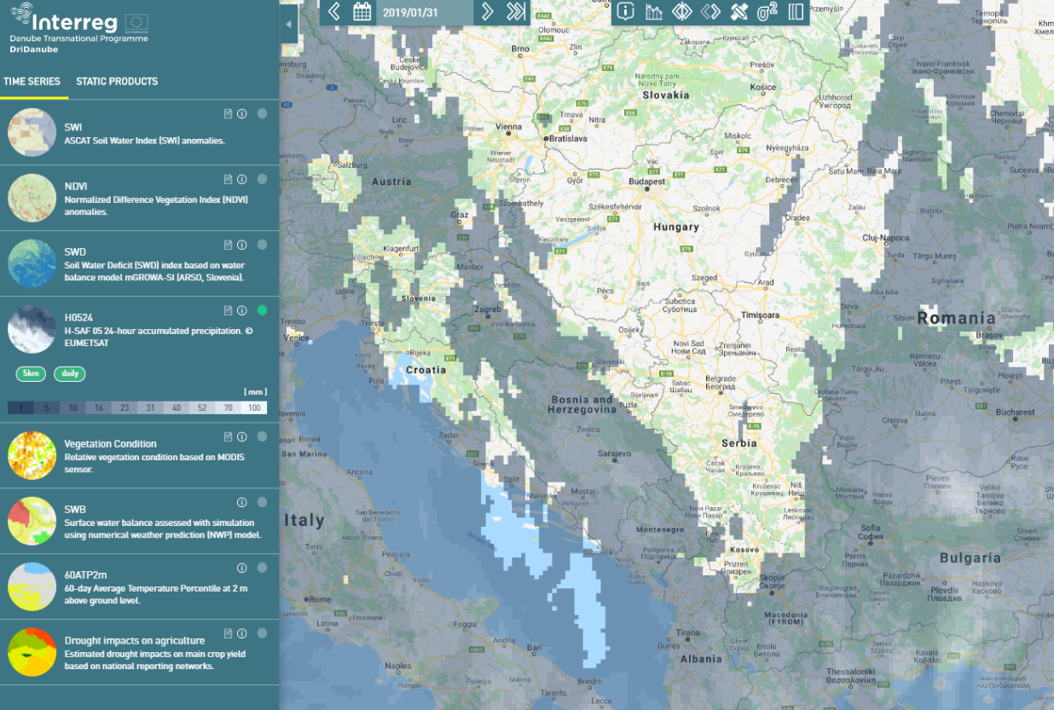
EUMETSAT Information day
FOCUS ON the use of satellite imagery: „Drought watch"
H-SAF 05
24-hour rainfall,
rhmz@teol.net Republic Hydro-Meteorological Service of Republika Srpska, B&H www.rhmzrs.com

Slide 11
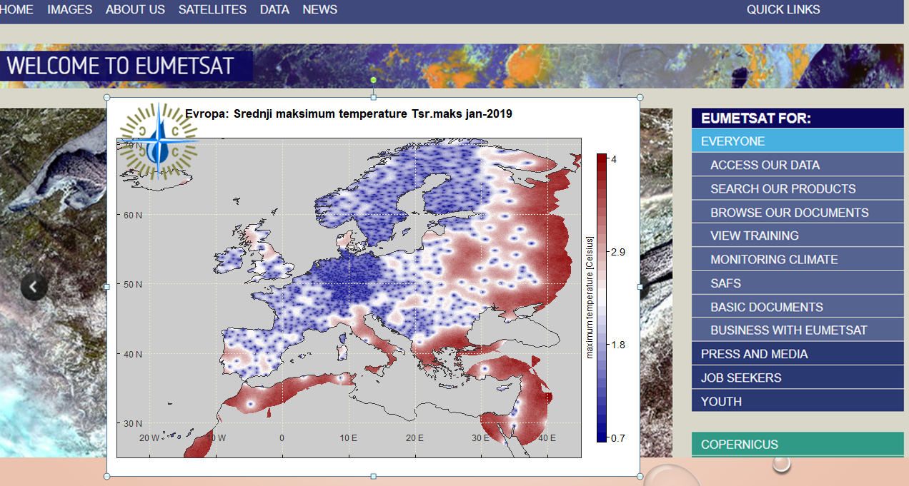
EUMETSAT Information day
FOCUS ON working with satellite formats in climatology RS
rhmz@teol.net Republic Hydro-Meteorological Service of Republika Srpska, B&H www.rhmzrs.com

Slide 12
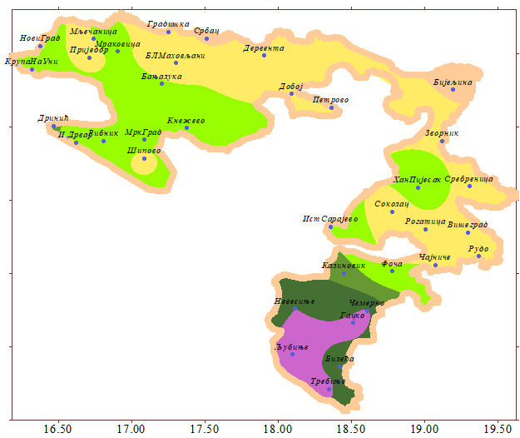
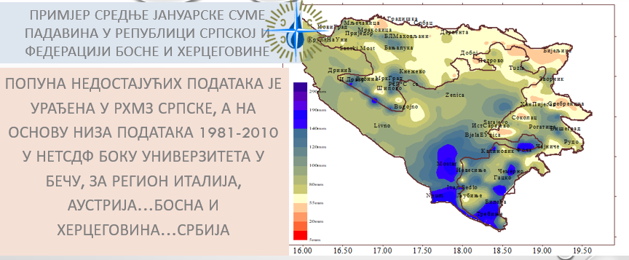
EUMETSAT Information day
FOCUS ON working with satellite formats in climatology RS EXAMPLES
RS: annual rainfall total, averaged over 1989-2018
BH: Januarries rainfall total, averaged over 1981-2010
rhmz@teol.net Republic Hydro-Meteorological Service of Republika Srpska, B&H www.rhmzrs.com

Slide 13
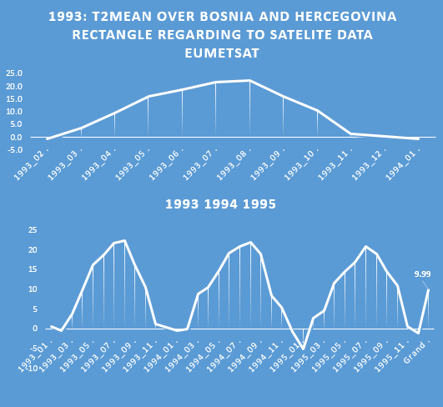
EUMETSAT Information day
FOCUS ON working with satellite formats in climatology RS EXAMPLES
FOR THE NEEDS OF THE NHMSs, ON THE REQUEST, OBTAINING SATELLITE DATA OF TEMPERATURE NEAR THE SURFACE OF THE EARTH, QUANTITY OF PRECIPITATION, CLOUDS, INSOLATION, SUN SHORT-TERM RADIATION ...
ON THE REQUEST, THE EUMETSAT CENTER SHOOT DATA THROUGH FTP CONNECTION AS SPECIAL FORMS (.tar.netCDF)
THE SATELITE DATA HELP OVER THE PERIOD OF NO MEASUREMENTS
(GRIDDED TEMP AND PRECIP DATA
rhmz@teol.net Republic Hydro-Meteorological Service of Republika Srpska, B&H www.rhmzrs.com

Slide 14
EUMETSAT Information day
FOCUS ON working with satellite formats in climatology RS
-EXAMPLES-
AIR TEMPERATURE AT 07,14,21H AS THE WAY OF GENERATING T_{MEAN} [T07+T14+2*T21]*1/4
EXAMPLE OF NETcdf4 FORMAT FORMATS OBTAINED ON THE REQUEST OF RHMZ SRPSKE OPENED BY THE PANOPLY SOFTWARE
rhmz@teol.net Republic Hydro-Meteorological Service of Republika Srpska, B&H www.rhmzrs.com

Slide 15
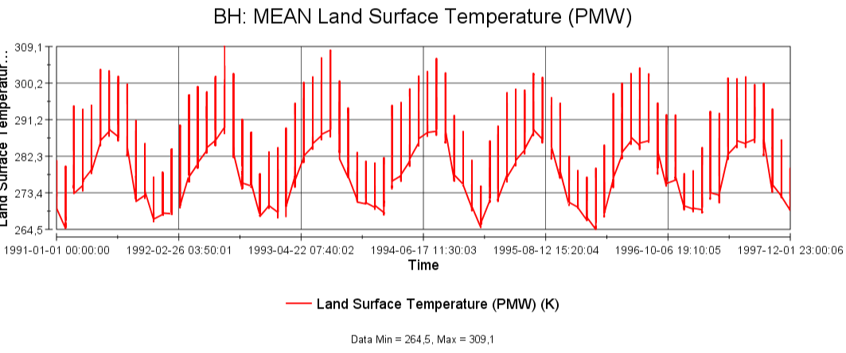
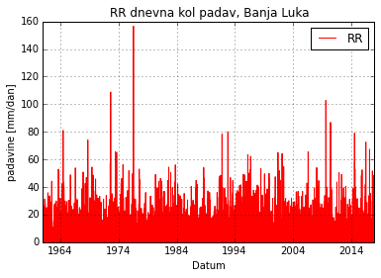
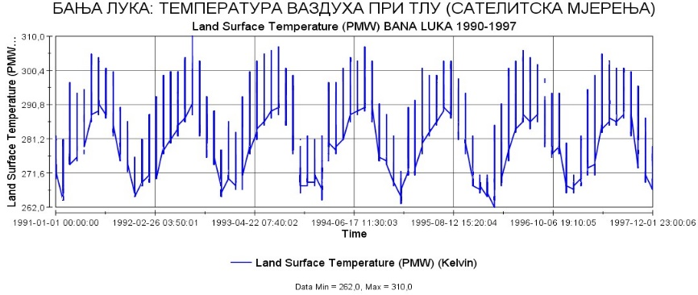
EUMETSAT Information day
FOCUS ON working with satellite formats in climatology RS -EXAMPLES-
PLOT GENERATED IN PANOPLY (JAVA PROG.LANG BASED)
PLOT GENERATED IN PYTON PROG.LANG
rhmz@teol.net Republic Hydro-Meteorological Service of Republika Srpska, B&H www.rhmzrs.com

Slide 16
Temp2m averaged over Bosnia and Herzegovina/satellite data

Slide 17
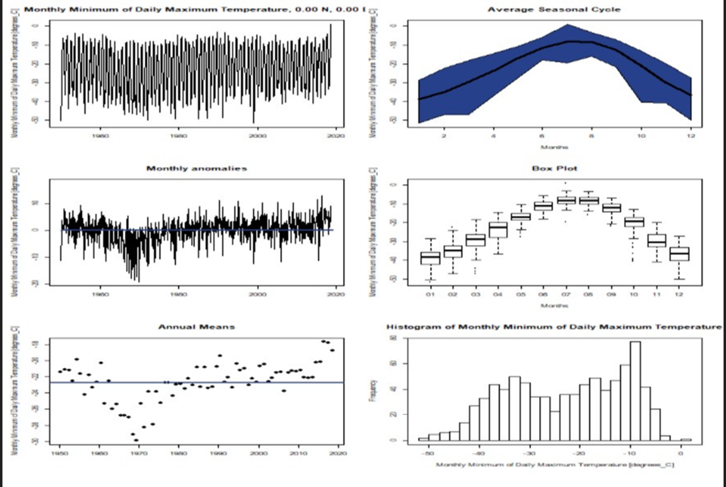
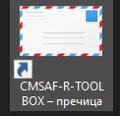
EUMETSAT Information day
FOCUS ON working with satellite formats in climatology RS -EXAMPLES-
CMSAF – txn analiza 1950-2017
CMSAF –TOOLBOX
on Climate Monitoring, established in Germany met service, R-prog. Lang based
THE CMSAF TOOLBOX PACKAGE, "R" Statistical support for .NC formats
rhmz@teol.net Republic Hydro-Meteorological Service of Republika Srpska, B&H www.rhmzrs.com

Slide 18
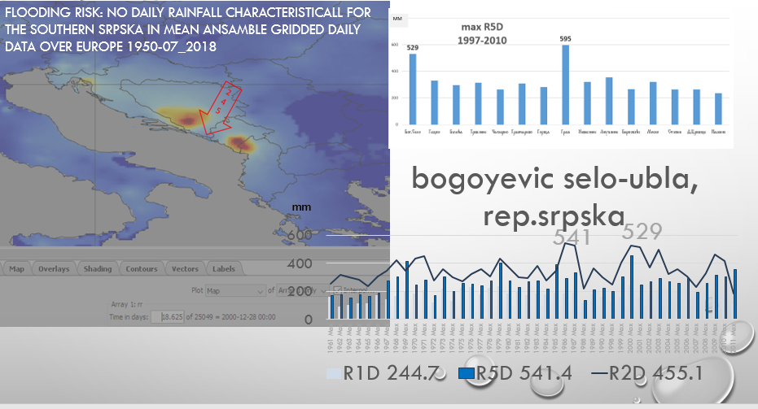
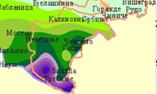
FLOOD RISKS: climate indexes ABS MAX OF R1D,R2D,R5D
-EXAMPLES of using nc extension of data series-E-OBS 1950/2018 daily level

Slide 19
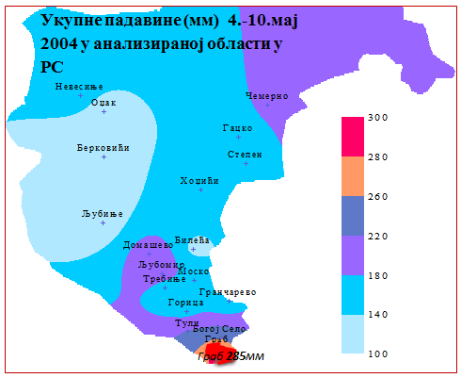
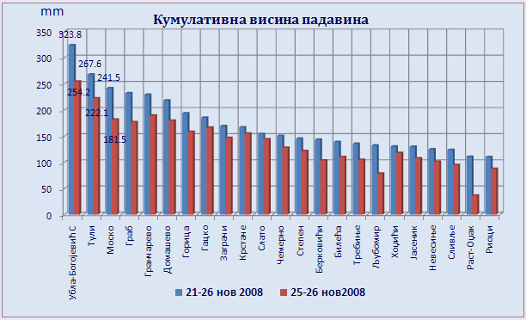
FLOODING RISK: SOUTHERN SRPSKA COUNTERED UP TO 300MM RAINFALL AT DAILY SCALE IN RECENT PAST, OVER 500MM FOR TWO DAYS (about 3000m annual aver)
HUGE RAINFALL : MAP USING GRIDDED CLIMATE DATA IN netCDF FORM ( E-OBS);
SPATIAL UNCERTAINITIES GIVES JUST UP TO 30MM PLUS AT DAILY LEVEL (MEAN ANSAMBLE) THAT IS INSUFICIENT yet

Slide 20
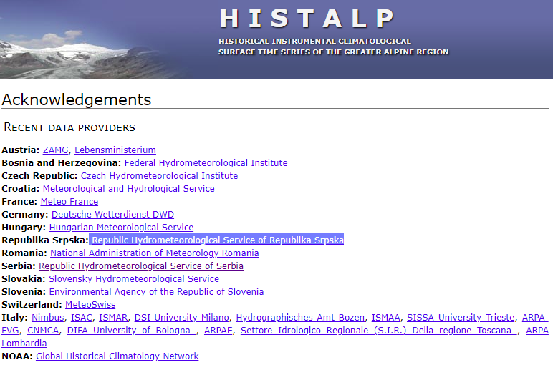
EUMETSAT Information day
FOCUS ON working with satellite formats in climatology
Here, you can find monthly data series for HISTALP region from 1780 FOR Tg, for precipitation from 1800 in NETCDF forms,
for the most of stations over Bosnia and Herzegovina
So it can be established that a similar positive temperature anomaly was also in the period 1852-1865, when insolation was the highest, which absolute maximum was not overcomed
In the recent past in time scale over 150 years
rhmz@teol.net Republic Hydro-Meteorological Service of Republika Srpska, B&H www.rhmzrs.com

Slide 21
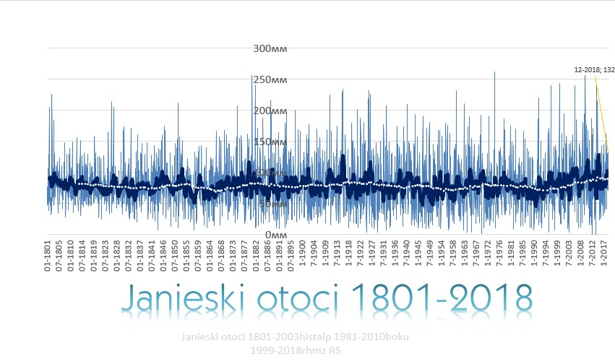
HISTALP-HISTORICAL TIME SERIES FOR ALPEAN REGION-BH AS SOUTH EASTERN PART OF
ЈАЊСКИ ОТОЦИ САТЕЛИТСКИ ФОРМАТ .NC 1800-2018

Slide 22
EUMETSAT Information day
Summary
Improving of monitoring system: both ones, meteorological and hydrological
Introducing hydrological forecast
Introducing numerical weather prediction through (NMM B model
and SEECOP consorcium for numerical prediction
Cross-border cooperations
International projects
rhmz@teol.net Republic Hydro-Meteorological Service of Republika Srpska, B&H www.rhmzrs.com

Slide 23
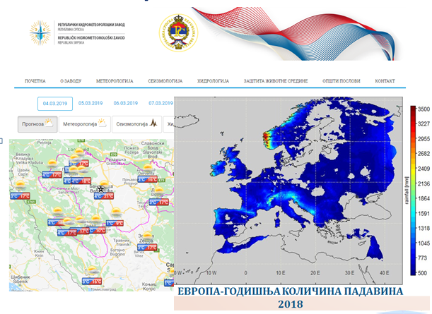
Republic Hydro Meteorological Service of the Republika Srpska
EUMETSAT Information day
Information Day
13-14 March 2019
Skopje,
North Macedonia
Thank you very much
For your attention!
European Organization for
the Exploitation of
Meteorological Satellites
MONITORING WEATHER
AND CLIMATE FROM SPACE
rhmz@teol.net Republic Hydro-Meteorological Service of Republika Srpska, B&H www.rhmzrs.com

